Slide 1
Software Engineering CS 487
Dennis Hood
Computer Science
Summer ‘19
Notes:
This template can be used as a starter file for presenting training materials in a group setting.
Sections
Right-click on a slide to add sections. Sections can help to organize your slides or facilitate collaboration between multiple authors.
Notes
Use the Notes section for delivery notes or to provide additional details for the audience. View these notes in Presentation View during your presentation.
Keep in mind the font size (important for accessibility, visibility, videotaping, and online production)
Coordinated colors
Pay particular attention to the graphs, charts, and text boxes.
Consider that attendees will print in black and white or grayscale. Run a test print to make sure your colors work when printed in pure black and white and grayscale.
Graphics, tables, and graphs
Keep it simple: If possible, use consistent, non-distracting styles and colors.
Label all graphs and tables.

Slide 2
Homework #5
Design the means of communication for the fish tank control system
Describe each instance of communication:
Include both communication out from the controller and in to the controller
Explain the purpose of each
Describe any “parameters” which will be passed
Define each instance as the command of your control system’s “language”
Use only 0’s and 1’s (binary language)
Minimize the length of each command
Be sure there is no ambiguity (commands must be unique)
Include error messages/codes where necessary
Please submit by 8/4/19

Slide 3
Lesson Overview
Service-Oriented Architecture and Embedded Systems
Reading:
Ch. 18 – Service-oriented Software Engineering
Ch. 19 – Systems Engineering
Ch. 20 – Systems of Systems
Objectives
Discuss the benefits of service/provider relationships
Examine the issues involved in designing and implementing such architectures
Analyze embedded systems issues including:
CCI (computer-computer interfaces)
Exception handling
Timing, etc.

Slide 4

Lecture 9
Service-Oriented Architecture and Embedded Software
Notes:
This is another option for an Overview slides using transitions.

Slide 5
Service-Oriented Architecture (SOA)
Based on the notion of cooperating entities
Entities offer to perform services
Information can be made available in a controlled and managed way
Defined interfaces must be published
Allows for the creation of configurable, distributed, platform-independent systems

Slide 6
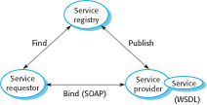
Service-Oriented Architecture

Slide 7
Web Services
A web service is an instance of a more general notion of a service:
“an act or performance offered by one party to another. Although the process may be tied to a physical product, their performance is essentially intangible and does not normally result in ownership of any of the factors of production.”
The provision of the service is independent of the application using the service
Service providers can develop specialized services and offer these to a range of service users from different organizations

Slide 8
SOA-related Standards
SOAP – SOA Protocol
Message interchange
Supports communication between services
WSDL – Web Services Definition Language
Service interface definition
Establishes definition for service operations and bindings
WS-BPEL – Web Services Business Process Execution Language
Workflow language

Slide 9
Benefits of SOA
Services can be provided locally or outsourced to external providers
Services are language-independent
Investment in legacy systems can be preserved
Inter-organizational computing is facilitated through simplified information exchange
Reuse

Slide 10
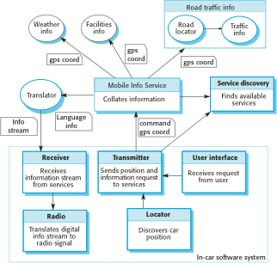
Ex.: Car Information System

Slide 11
Ex.: Car Info Systems (cont.)
It is not necessary to decide when the system is programmed or deployed what service provider should be used or what specific services should be accessed
As the car moves around, the in-car software uses the service discovery service to find the most appropriate information service and binds to that
Because of the use of a translation service, it can move across borders and therefore make local information available to people who don’t speak the local language

Slide 12
Reusable Services
Once established, a service can be used by any number of “systems”
Well-defined interface
Consistent, reliable performance
Independent and loosely coupled
WSDL specification
What – the interface description
How – details of how to communicate
Where – the location of the implementation

Slide 13
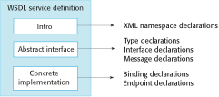
WSDL Specification

Slide 14
Service Types
Utility services
General functionality
e.g., currency conversion
Business services
Associated with a specific business function
e.g., student registration
Coordination of process services
Support more general business processes
e.g., procurement process management

Slide 15
Service Engineering
The process of developing services for reuse in service-oriented applications
The service has to be designed as a reusable abstraction that can be used in different systems
Generally useful functionality associated with that abstraction must be designed and the service must be robust and reliable
The service must be documented so that it can be discovered and understood by potential users

Slide 16
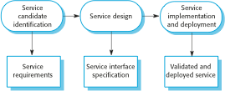
Service Engineering

Slide 17
Service Testing Considerations
Control or even access to external services is determined by the service provider
An application may not always use the same service each time it is executed
Performance may differ under varying loads – loads which can vary greatly depending on the number and frequency of service requests
Testing of exception handling may depend on proper failure of dependent services

Slide 18
Embedded Systems
Characteristics
Software embedded in hardware
Minimal user interface / interaction
Real-time response to environmental change
A product of the environment
Performance
Proper performance means a correct response within an acceptable time
Availability is expected
Safety and reliability issues are prominent in design decisions

Slide 19
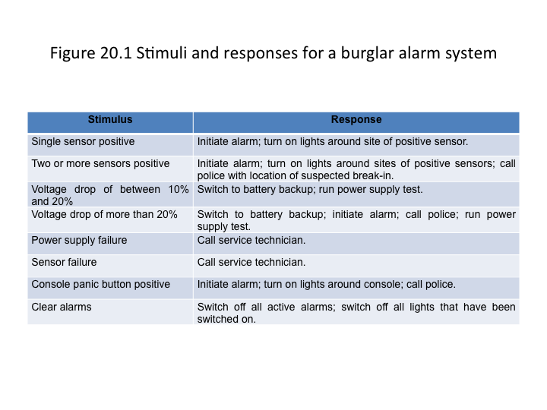

Slide 20
Design Considerations
Platform selection
Timing, power, environment, OS, etc.
Stimuli response
Periodic vs. aperiodic stimuli
Timing requirements
Process architecture
Aggregate stimuli and response processes
Algorithms to support computations
Data architecture
Process scheduling

Slide 21
Process Coordination
Processes in a real-time system have to be coordinated and share information
Process coordination mechanisms ensure mutual exclusion to shared resources
When one process is modifying a shared resource, other processes should not be able to change that resource
When designing the information exchange between processes, you have to take into account the fact that these processes may be running at different speeds

Slide 22
Real-time System Modelling
The effect of a stimulus in a real-time system may trigger a transition from one state to another
State models are therefore often used to describe embedded real-time systems
UML state diagrams may be used to show states and state transitions in a real-time system

Slide 23
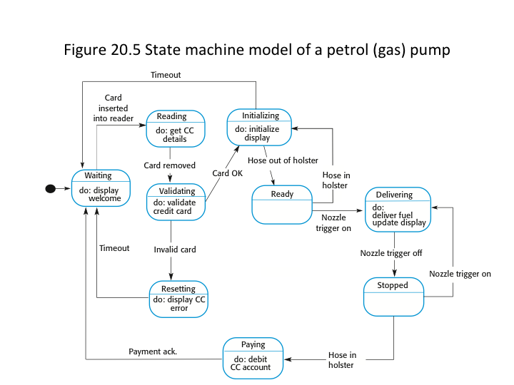

Slide 24
Real-time Design Patterns
Observe and React
Sensors are monitored and status displayed
Sensor change initiates handler
Environmental Control
Sensors monitor the environment and actuators adjust it
Sensor change initiates signals to actuators
Process Pipeline
Data transformation is required before processing
Separate processors to handle concurrent transformations

Slide 25
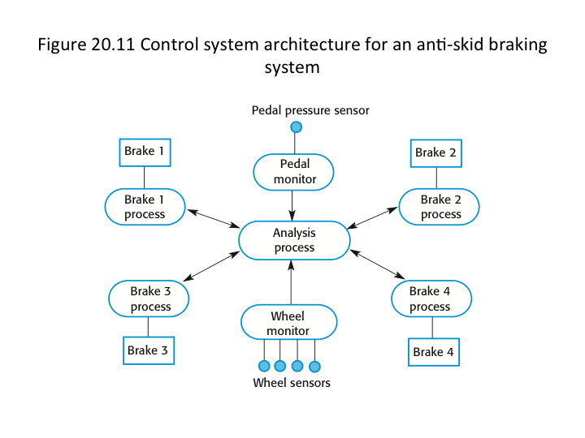

Slide 26
Timing Analysis
The correctness of a real-time system depends on both the correctness of the outputs as well as the time at which they are produced
Timing can be difficult with a mixture of periodic and aperiodic stimuli and responses
Key factors in analyzing timing requirements:
Deadlines – the time by which stimuli must be processed
Frequency – the number of times per second that a process must execute
Execution time – the time required to process a stimulus and produce a response (consider both average and worst-case)

Slide 27
Real-time Operating Systems
Real-time applications often require a more efficient and responsive real-time operating systems
RTOS components:
A real-time clock for periodic events
An interrupt handler for aperiodic requests
A scheduler for examining and selecting processes for execution
A resource manager for allocating system resources such as memory
A dispatcher for starting the execution of processes

Slide 28
